Slide 1



OBJECT ORIENTED PROGRAMMING
MINI PROJECT
Guided By
Arpit Deo Sir
Presented By
EN20CS301330 Rahi Jain
EN20CS301344 Rhyna Sussana John EN20CS301357 Riya Nagar

Slide 2
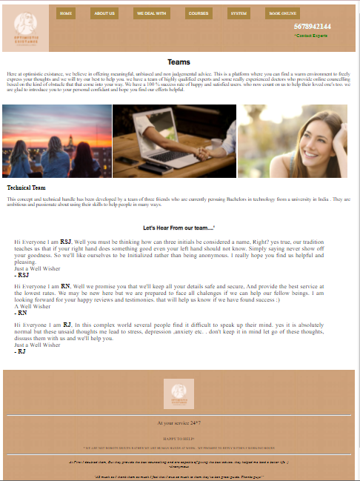

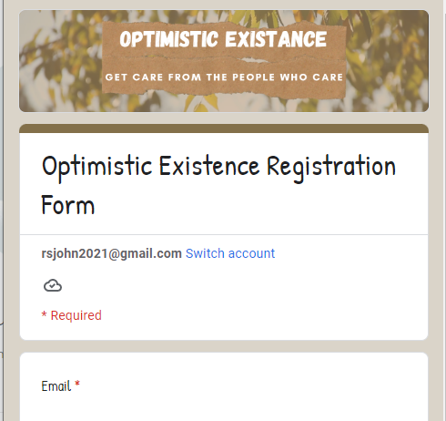
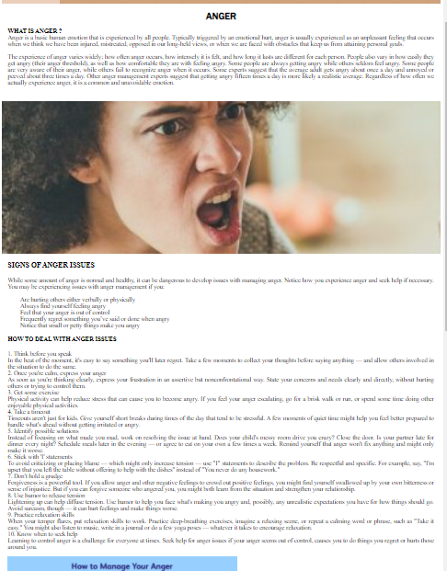
INDEX
About Optimistic existance
Live tour through our website
About HTML
About CSS
About JavaScript
Benefits
Planned Upgrades

Slide 3

Why Optimistic Existance
Like The name suggests , our website is a platform to empower diverse individuals, families, and groups to accomplish mental health, wellness, education, and career goals.
We are essentially meant to prevent and alleviate human suffering. We promote peace within and amongst all people. We believe in humanity, respect and diversity within social groups. Our Vision is to help people lead a healthy and productive life.

Slide 4




A website created using HTML CSS and JAVA SCRIPT
Take a live tour with us through OPTIMISTIC EXISTANCE
CLICK HERE - OPTIMISTIC EXISTANCE HOME PAGE

Slide 5







INTRODUCTION TO HTML
The Hyper Text Markup Language, or HTML is the standard markup language for documents designed to be displayed in a web browser. It can be assisted by technologies such as Cascading Style Sheets (CSS) and scripting languages such as Javascript.
HTML Tags are keywords surrounded by angle brackets like <html>. They most commonly come in pairs like
and , although some
represent empty elements and so
are unpaired, for example .

Slide 6
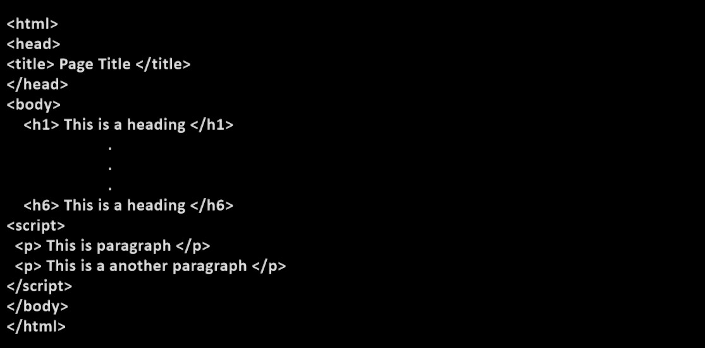
HTML PAGE STRUCTURE

Slide 7
HTML TAGS
<html>,</html> | Describe HTML web page
<head>,</head> | This defines the header section of the page.
<title>,</title> | This shows a caption in the title bar of the page.
<body>,</body> | This tag show contents of the web page.
<br>,<br/> | We can use this tag if you want a line break or a new line without starting a new paragraph.
<hr>,</hr> | Defines a horizontal rule.
<a href=“ “>, </a> | It is used to define html links. <a href=http://www.gmail.com>gmail</a>

Slide 8
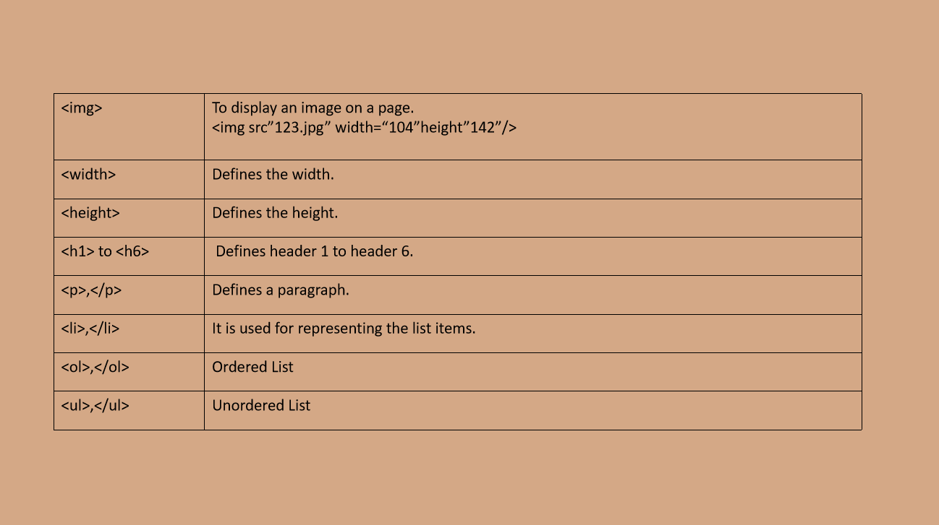

Slide 9



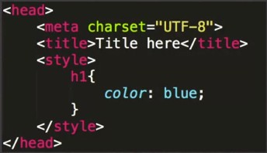
INTRODUCTION TO CSS
CSS Stands for CASCADING STYLE SHEETS
CSS is a computer language for laying out and structuring web pages
It Adds styles ( fonts, background, colours, spacing) to the html documents
SELECTOR {
PROPERTY: VALUE;
}
EXTERNAL STYLE SHEET
An external style sheet is a separate CSS file that can be accessed by creating a link within the head section of the webpage. The link to an external style sheet is placed within the head section of the page.
INTERNAL STYLE SHEET
An internal CSS is
used to define a style
for a single HTML
page. An internal CSS
is defined in the
<head> section of an HTML page, within a
<style> element.

Slide 10
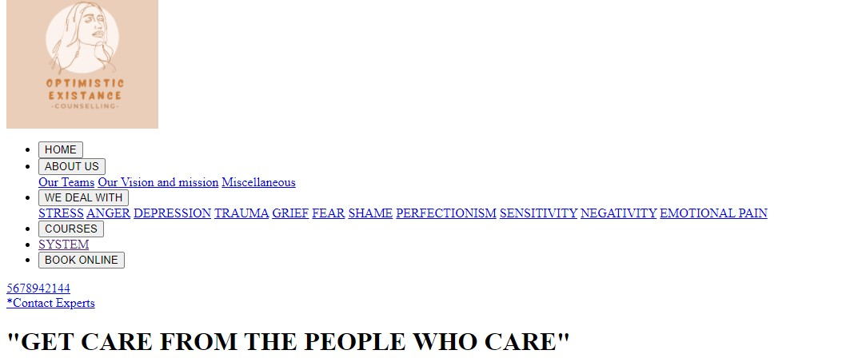
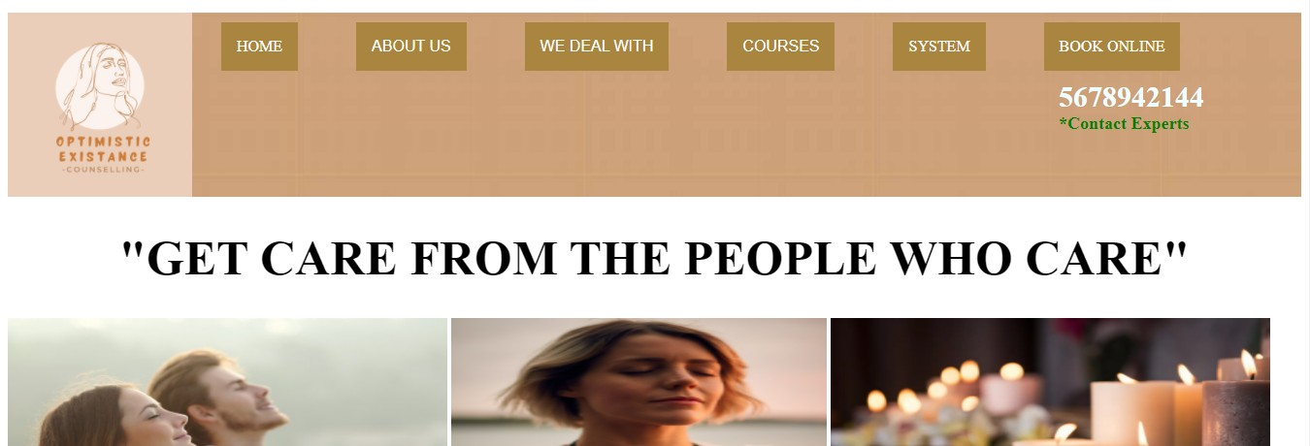
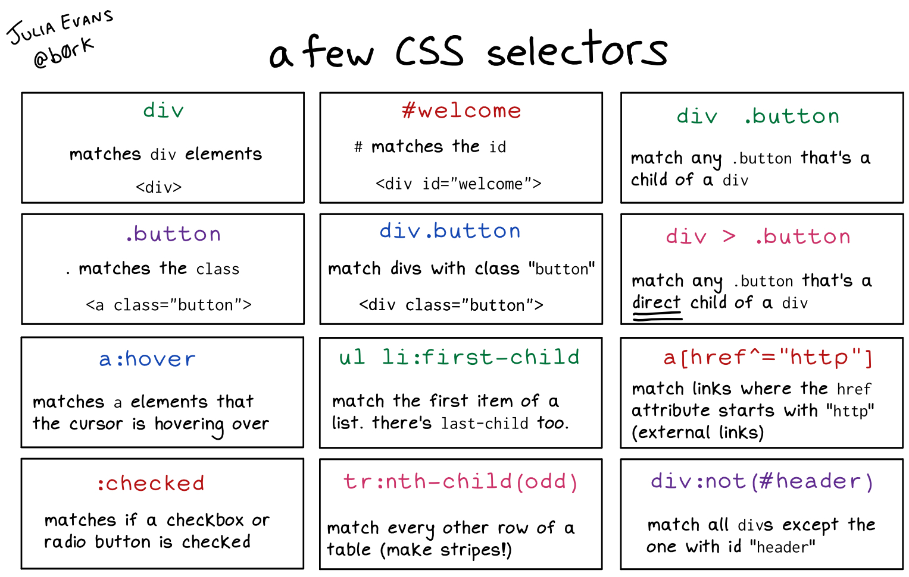
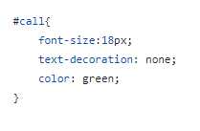
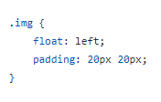
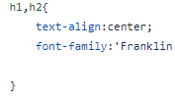
WITHOUT CSS
WITH CSS
EXAMPLES FROM THE CODE

Slide 11
OBJECT ORIENTED CSS
Object-oriented CSS is a CSS methodology developed and promoted by Nicole Sullivan (Product Manager @ Google Chrome ).
The focus of OOCSS is the idea of treating page elements as objects, giving all these objects classes, treating objects’ classes as single entities in style sheets, and reusing them in many documents
WHY USE OOCSS
Scalable
Boosts in site Speed
Saves a lot of time and effort
Maintainable
Readable
Reusable

Slide 12
CSS TAGS
background | A shorthand property for all the background-* properties
background-color | Specifies the background color of an element
font | A shorthand property for the font-style, font-variant, font-weight, font-size/line-height, and the font-family properties
height | Sets the height of an element
padding | A shorthand property for all the padding-* properties
text-decoration | Specifies the decoration added to text
width | Sets the width of an element
align-content | Specifies the alignment between the lines inside a flexible container when the items do not use all available space

Slide 13
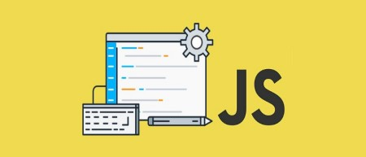
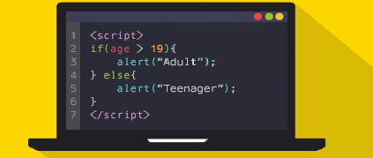
INTRODUCTION TO JAVASCRIPT
JavaScript is a object-based scripting language that is used to handle and validate client-side data. JavaScript is also used for making the user interface of the web pages more dynamic making it responsive to events like the movement of the mouse, mouse click on a certain HTML element, a button click etc using which we can improve the user experience.

Slide 14
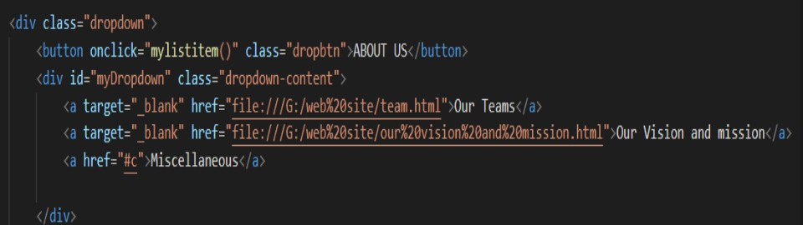
JavaScript Button Code
Adding HTML
Html makes the page static but JavaScript adds dynamic and interactive content to it.

Slide 15
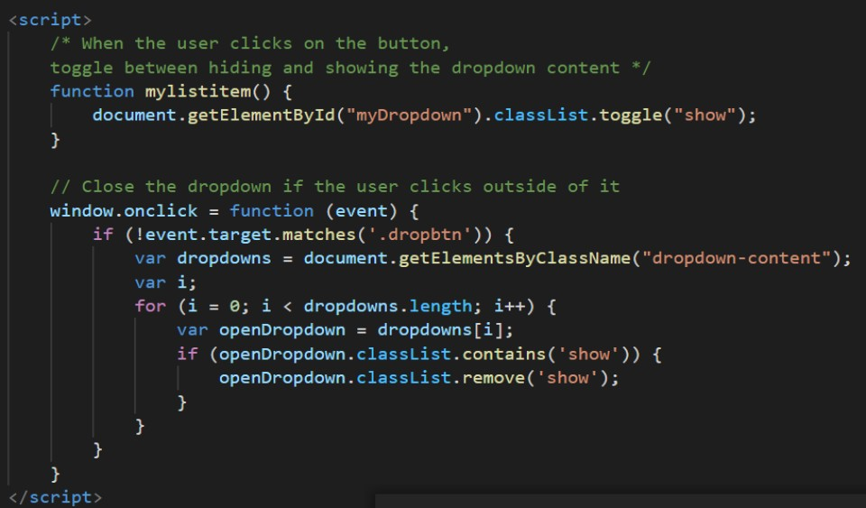
Adding JavaScript

Slide 16
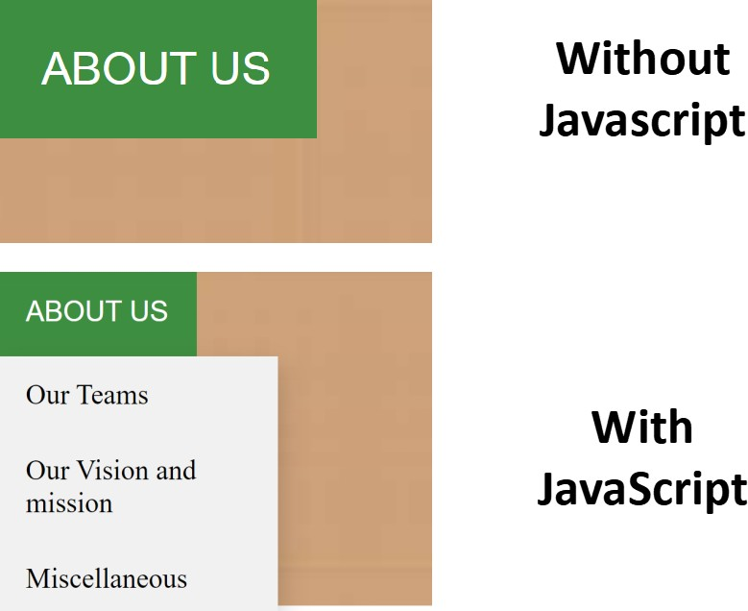

Slide 17
BENIFITS OF OPTIMISTIC EXISTANCE
Web counselling is easily accessible to all those who wish to use it
For those individuals who are ambivalent about therapy or who may be uncomfortable with traditional models of therapy, may find online counselling more suitable Treatment Can Be More Approachable
Scheduling Flexibility
Online counselling provides anonymity and convenience.
E-counselling is a time-saving, convenient and accessible form of therapy.

Slide 18
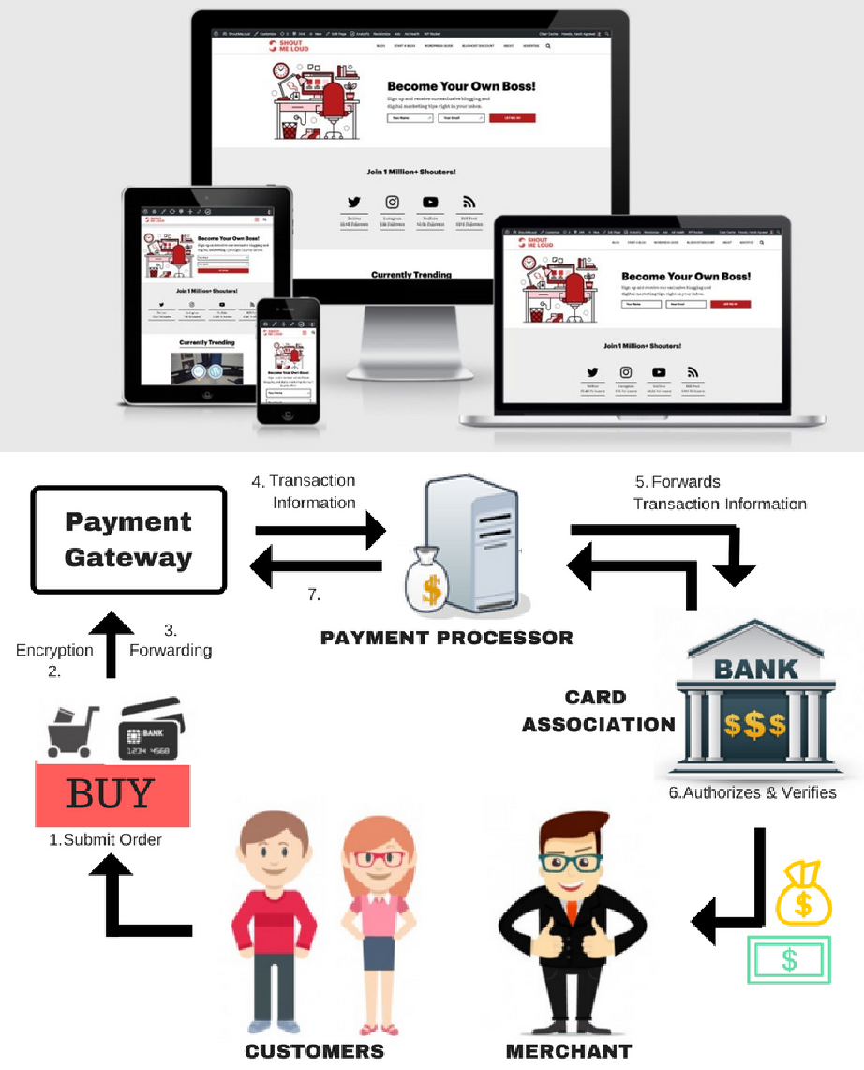
UPGRADES NEEDED
We need to upgrade the site to be responsive to phone tablet and other devices . Also our plans are to further develop an android application for the same .
We need to develop a digital money transaction gateway for secure and hassle free transaction.
We also plan to find some investors and doctors to invest time and sources to further develop this website

Slide 19

THANK YOU!

